Slide 1


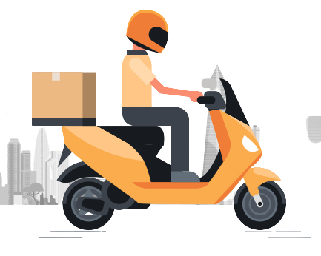
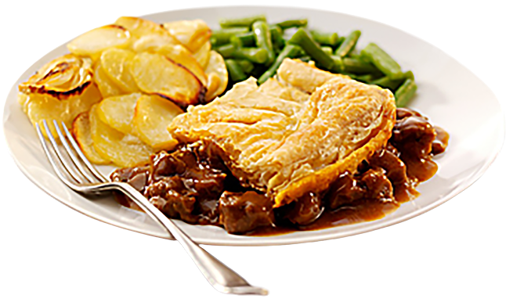
FOOD ORDERING SYSTEM

Slide 2
PRESENTED BY:
NAME ID INTAKE-SECTION
MD.HASAN MIA 20245103381 53-10
MAHATHIR MOHAMMAD RAHIM 20245103390 53-10
FAMID KHANDOKER 20245103392 53-10
MD.RYIN AKAND 20245103399 53-10
SIFATH HOSSAIN 20245103400 53-10

Slide 3
TABLE OF CONTANT
01.INTRODUCTION
05.PROBLEM SOLUTION
04.PROBLEM STATEMENT
06.SYSTEM DESIGN
07.CHALLENGES FACED
08.CONCLUSION
02.OBJECTIVES
03.FEATURES

Slide 4
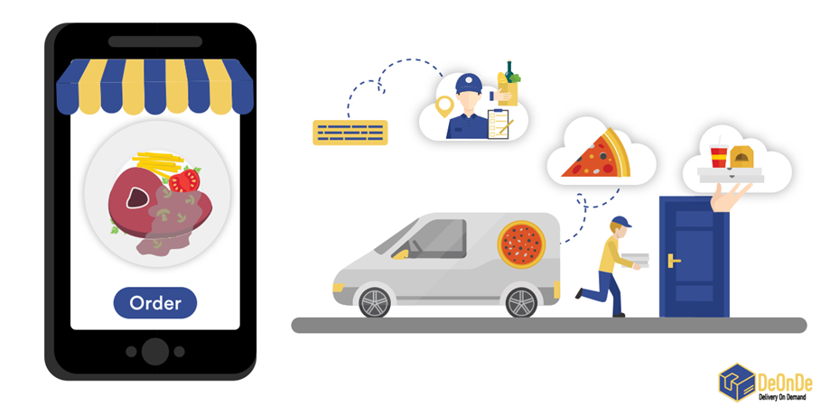
Introduction
Online ordering system that I am proposing here, greatly simplifies the ordering process for both the customer and the restaurant. System presents an interactive and up-to-date menu with all available options in an easy to use manner. Customer can choose one or more items to place an order which will land in the Cart. Customer can view all the order details in the cart before checking out. At the end, customer gets order confirmation details. Once the order is placed it is entered in the database and retrieved in pretty much real time. This allows Restaurant Employees to quickly go through the orders as they are received and process all orders efficiently and effectively with minimal delays and confusion

Slide 5

Objective
To Develop a system that will allow customers to place their food order online and provide them with feedback as to the calorie and fat count of the meal, a generic image of the meal, a list of side dishes, main course ingredients, and cost information.

Slide 6
FEATURES
Menu display with categories and stock details.
Dynamic order management with stock updates.
Error handling for invalid inputs and out-of-stock scenarios.
Automatic bill calculation with itemized details.

Slide 7
PROBLEM STATEMENT
Ordering food has become a daily necessity, but traditional methods like calling or visiting a restaurant can be time-consuming and inconvenient.
Customers often face challenges such as long waiting times, unclear menus, and difficulties in placing orders. Restaurants also struggle with managing orders, ensuring accuracy, and providing fast service.

Slide 8
PROBLEM SOLUTION
Browse Menus Easily – Customers can view updated menus with prices and descriptions.
Place Orders Quickly – Orders can be placed with just a few clicks.
Track Orders – Customers can see the status of their orders in real time.
Pay Conveniently – Multiple payment options (card, wallet, or cash on delivery) will be supported.
Save Preferences – Users can save their favorite orders and personal details for faster ordering next time.

Slide 9
SYSTEM DESIGN
Customer places an or
Customer places an order
System confirms order
Restaurant processes order
Order delivery
Customer tracks order

Slide 10
SYSTEM DESIGN

Slide 11
CHALLENGES FACED
Challenges:
Handling large menus and multiple orders.
Ensuring accurate data input and avoiding errors.
Implementing payment integration in C.
Solutions:
Breaking down tasks into smaller functions.
Using error handling and validation techniques.

Slide 12

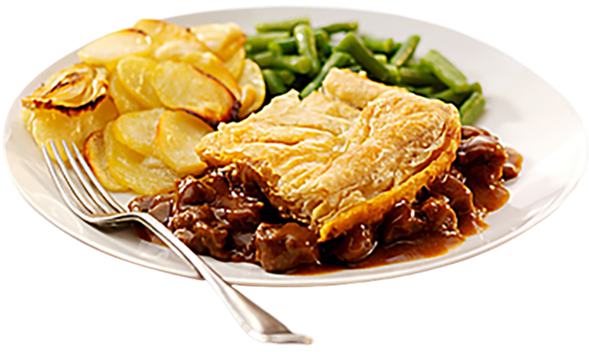
CONCLUSION
The Food Ordering System developed using C programming has successfully addressed the challenges associated with traditional food ordering methods. By automating the order process, the system offers an efficient, user-friendly platform for customers to place and manage their food orders.

Slide 13
Thank you!

Slide 14


